Slide 1
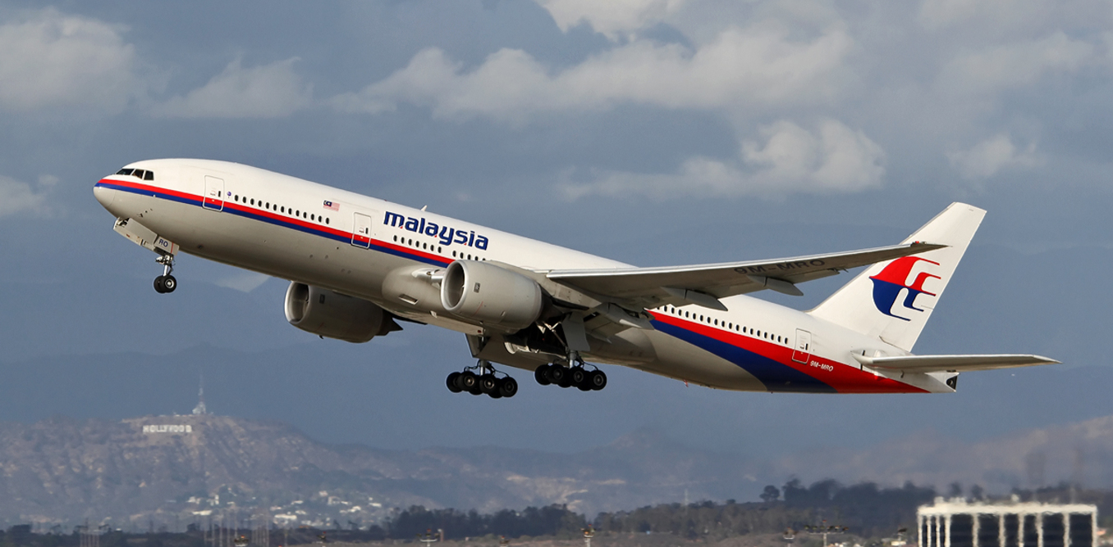
Flight Fare Prediction

Slide 2
Objective
This Flask web app predicts the price of a flight based on various factors like source destination, departure date, arrival date, number of stoppage etc.
Benefits:
This project helps users to book flights at lowest rates and save money as it predicts the actual amount that should be there for that source destination travel.

Slide 3
Architecture
Start
Data collection
Data pre processing
Feature selection
One Hot encoding
Model dump in PKL file
Check accuracy score
Hyper Parameter tuning
Model Training
Model Creation
Creating front end
integration
Test check
Deploy
End

Slide 4
Data collection
I have dataset of 10k rows which includes all the parameters needed to predict the price of the flight . Information such as to, from, number of stoppage, date of travel are some of the parameters
Data Insertion into Database
Database Creation and connection - Create a database with Cassandra cloud version and connect to the database
b. Insert the user input in data base and store It database is work as a hidden API in entire project
Export Data from Database
Take the user input and store in Cassandra database

Slide 5
Data Preprocessing
1. Null values in column- we checked if columns had null values or not
2. Date of journey was dropped as we had arrival departure date and date of journey that could be set as per date of journey
3. We applied one hot encoding on Airline name and destination as it was a categorical column and need to be encoded before training
4. Modifying number of stops column to extract only numerical value from alphanumeric column.
Feature Selection
We dropped date of journey column and route as they were unnecessary for model training

Slide 6
Model Training
After the completion of the above process I split the dataset into test and train. I use various classification algorithm like Decision trees, Random Forest, K-NN, Bagging, XgBoost, Random forest Regressor and validate the accuracy. Finally I select the best algorithm and check the accuracy on train and test data. I used Accuracy score which validates the variance from model prediction to ground truth.
Hyper parameter Tuning
Here I have used Randomized Search CV for selection of the best parameters to reduce overfitting criteria. Along with this I have used k fold cross validation technique for training of the model and finally got 80% accuracy.

Slide 7
Model Dump with pkl file
I have saved the model using pickle
Creation of front end
As per the required parameters for the user to predict the income I have created the front end in order to link with the Flask App. Here the styling and formatting of the html page is taken care with the CSS file.
Flask Web App
I have created a Flask Web App where I read the contents from the pickle file and made sure it linked to the html file to predict the income.
Deployment
I have deployed the app on Heroku platform but I have prepared a docker container to help user in order to deploy on other platforms as well.

Slide 8
Q/A
Q. What was the source of data?
The source of data was in CSV format having 10K columns
Q2.What was the type of data?
The data was the combination of numerical and Categorical values
Q3. How logs are managed?
Loggers are implemented in each and every module and function. All logs are being captured and recorded in a separate log file.
Q4) What techniques were you using for data pre-processing?
1.Removing unwanted attributes
2.Visualizing relation of independent variables with each other and output variables
3.Checking and changing Distribution of continuous values
4.Removing outliers
5.Cleaning data and imputing if null values are present.
6.Converting categorical data into numeric values.
Scaling the data

